Slide 1
Cousera capstone project - presentation

Slide 2
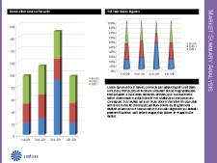
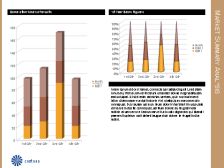
Using the Pitchbook Template
Project description
The Mayor of Mississauga, has floated a RFP for finalizing the location for an Italian restaurant in Port credit area.
They wanted analysis of the existing business and particular restaurants to ensure Italian restaurant would indeed be successful.
Aruna Dorai Inc was one of the shortlisted agencies to be invited to present a proposal to address this problem.
Aruna Dorai Inc was an acclaimed consulting agencies using Data science and Machine learning for all their projects. They have a proven track record of success. They keep up with the latest trends in Data and information management.
They have a proven solutioning process for informative problem solving.

Slide 3
Who can use this report ?
This report is specifically created for the Mississauga mayors office, however can be used by zoning officers or new small businesses trying to enter the market in the south Mississauga (Port Credit) neighborhood.
Port Credit neighborhood is one of the affluent communities with beautiful custom homes and manicured gardens. The demographic is mostly double income families and has discretionary amount for going to restaurants.

Slide 4
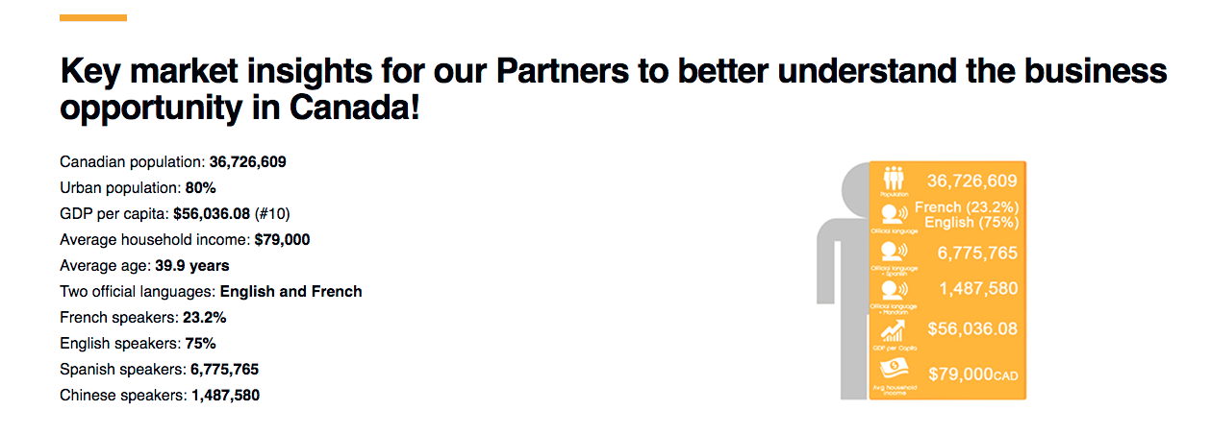
Opportunity in Canada

Slide 5
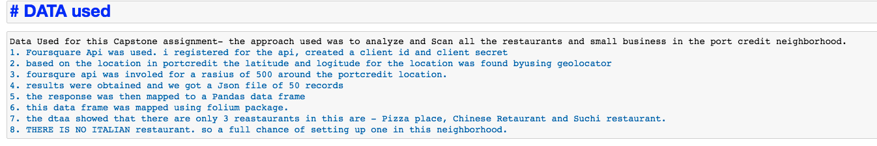
Coursera capstone project

Slide 6
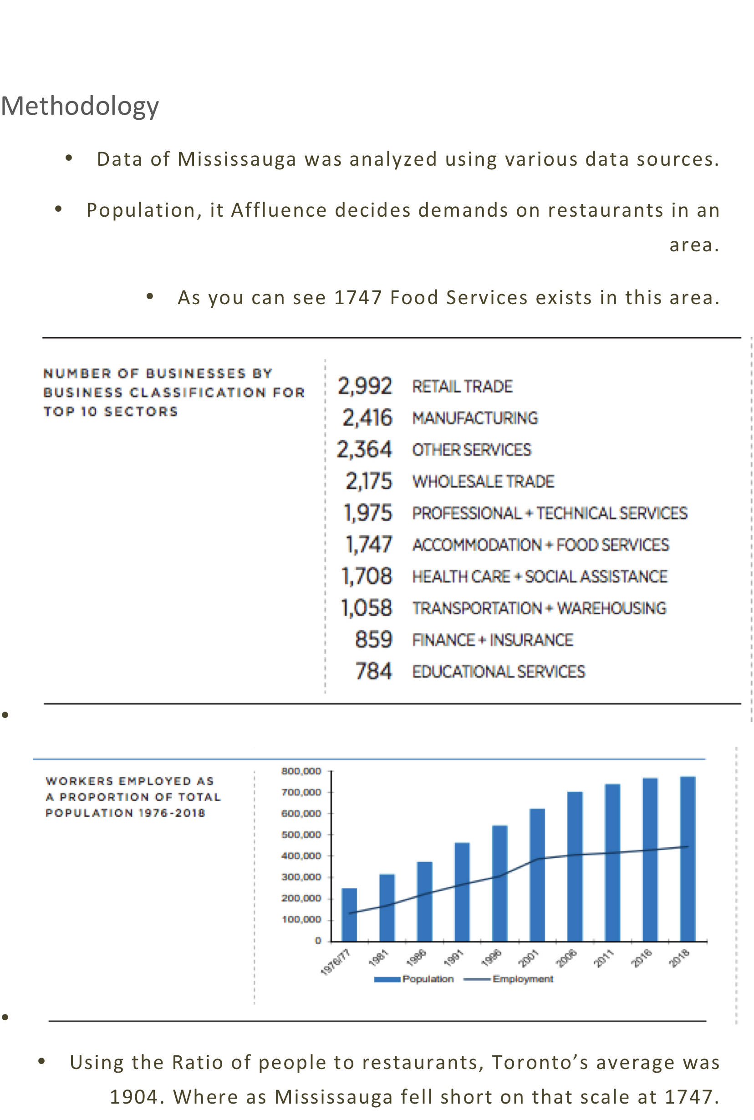

Slide 7
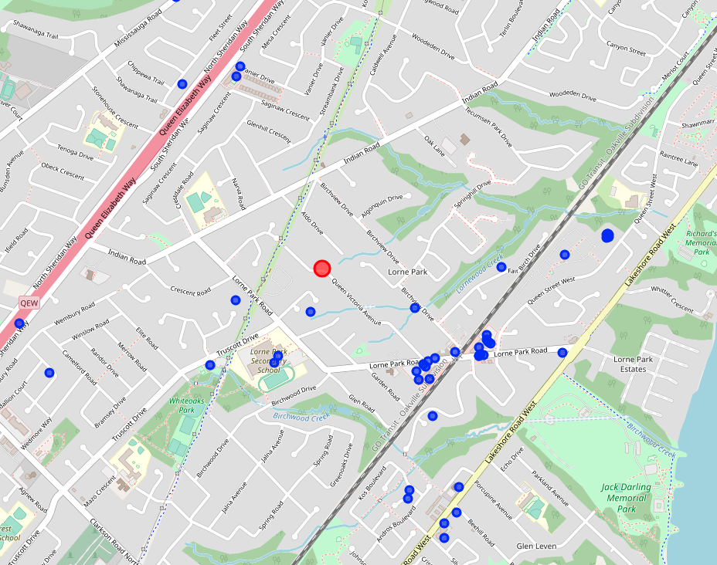
Red circle denotes – Proposed location for restaurant
Blue circle denotes small business around this address
Only 3 eateries were found – Pizza, Sushi and Chinese restaurant.

Slide 8
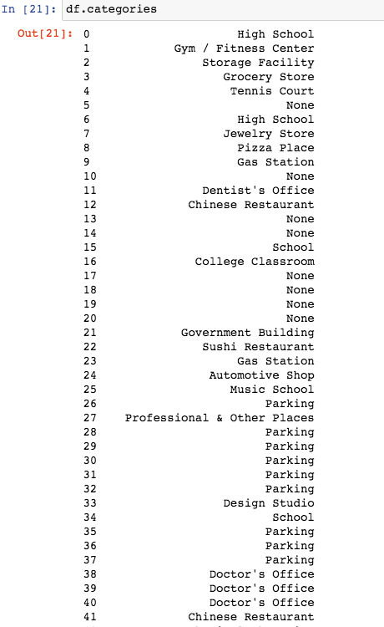
Data set used -------

Slide 9
